Slide 1

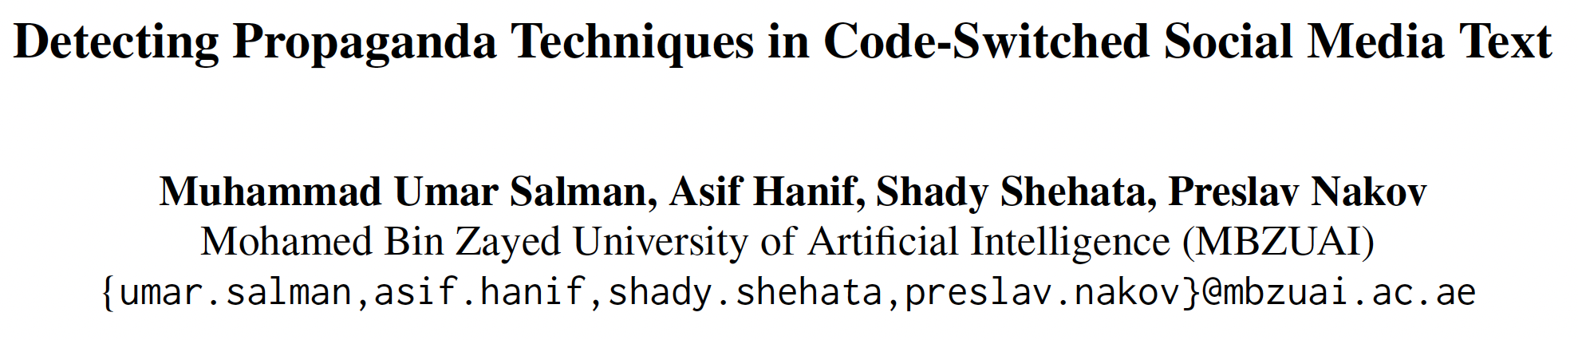

Detecting Propaganda Techniques in Code-Switched Social Media Text

Slide 2
Background

Slide 3
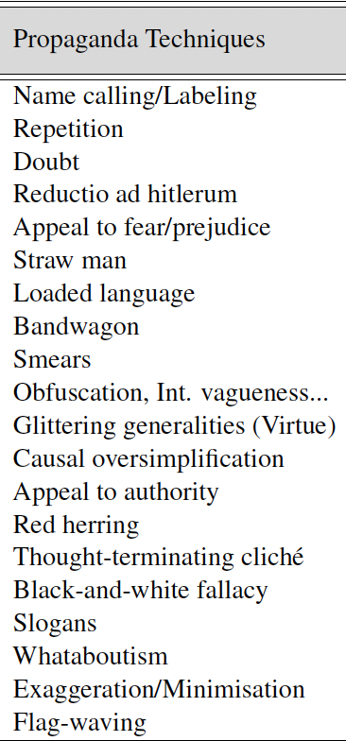
Propaganda is a form of communication intended to influence the opinions and the mindset of the public to promote a particular agenda.
Code-switching is the mixing of multiple languages within the same text
Example: I was talking to my friend about the weather, aur phir humne decide kiya ke kal picnic pe jaenge
1. Dimitrov, Dimitar, et al. "Detecting propaganda techniques in memes." arXiv preprint arXiv:2109.08013 (2021).

Slide 4
Motivation
4

Slide 5
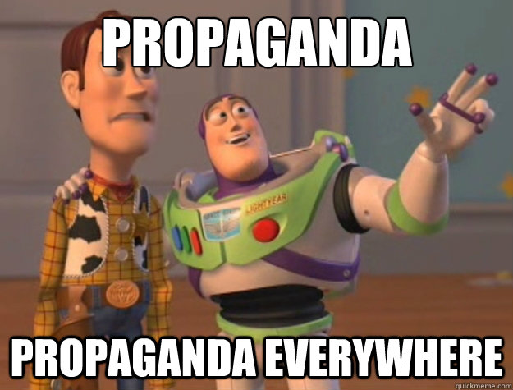
Why is there a need?
Popularity of social media and prevalence of propaganda
Propaganda’s negative effect on people
Presence of multilingual communities on social media
Presence of code-switched text on social media platforms
Need for propaganda detection systems

Slide 6
Contribution
6

Slide 7
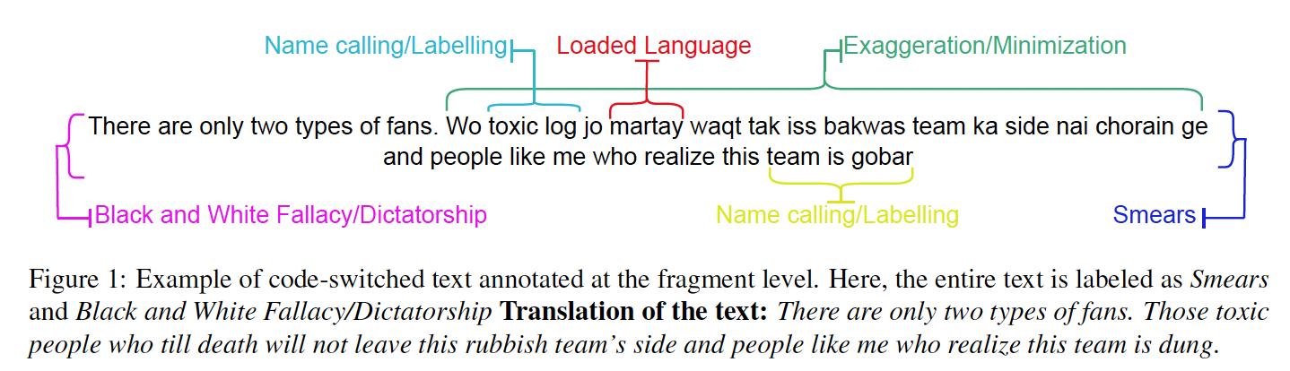
Our Contributions
Formulation of novel task.
Creation of annotated code-switched dataset
Comparative analysis through running multiple experiments

Slide 8
Dataset

Slide 9
Dataset Collection
Dataset Sources: Twitter, Facebook, Instagram and YouTube
Four collectors (500 code-switched texts each)
Collectors selection criteria
Dataset filtering for quality purposes
Ethical considerations

Slide 10
Annotator Training
Details about annotators
Annotating propaganda techniques is a challenging task
Annotator’s training stages
Annotator’s feedback stage

Slide 11
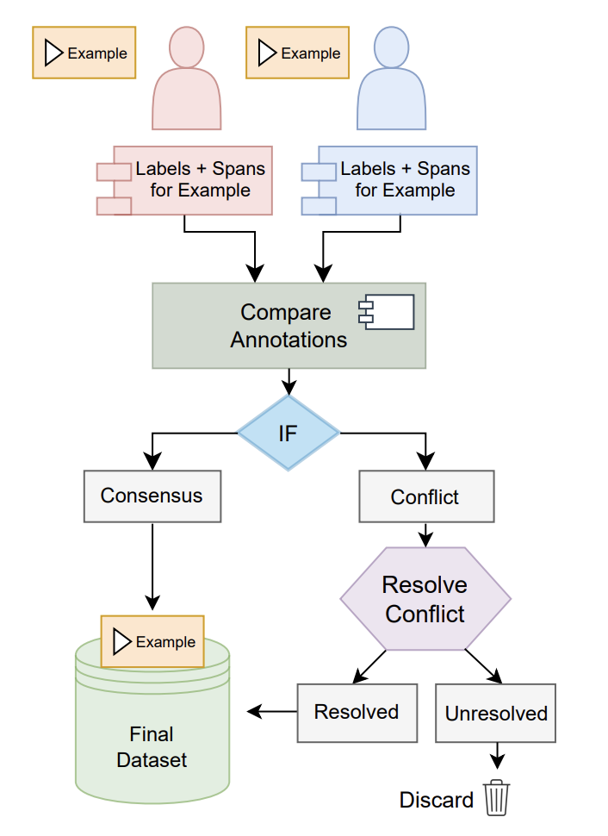
Annotation Process
Quality of Annotations
Krippendorff’s α [3] score between the two annotators for our annotations is 0.76
[3] Krippendorff, Klaus. "Agreement and information in the reliability of coding." Communication methods and measures 5.2 (2011): 93-112.

Slide 12
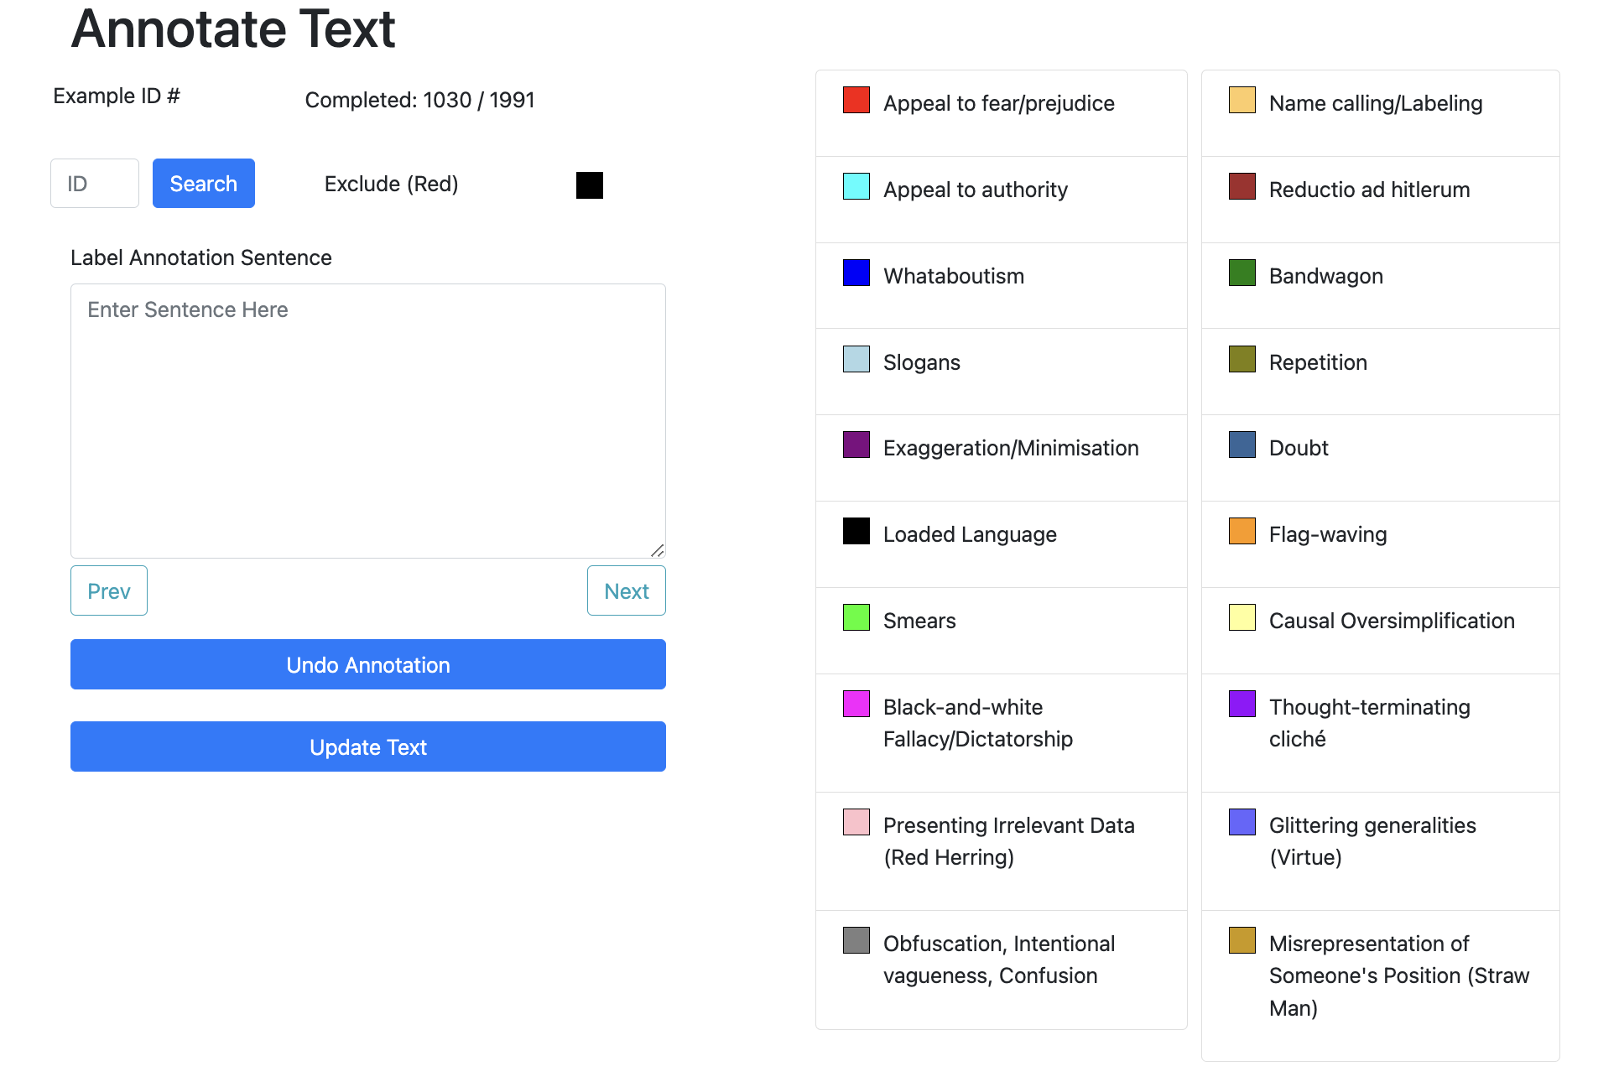
Annotation Platform

Slide 13
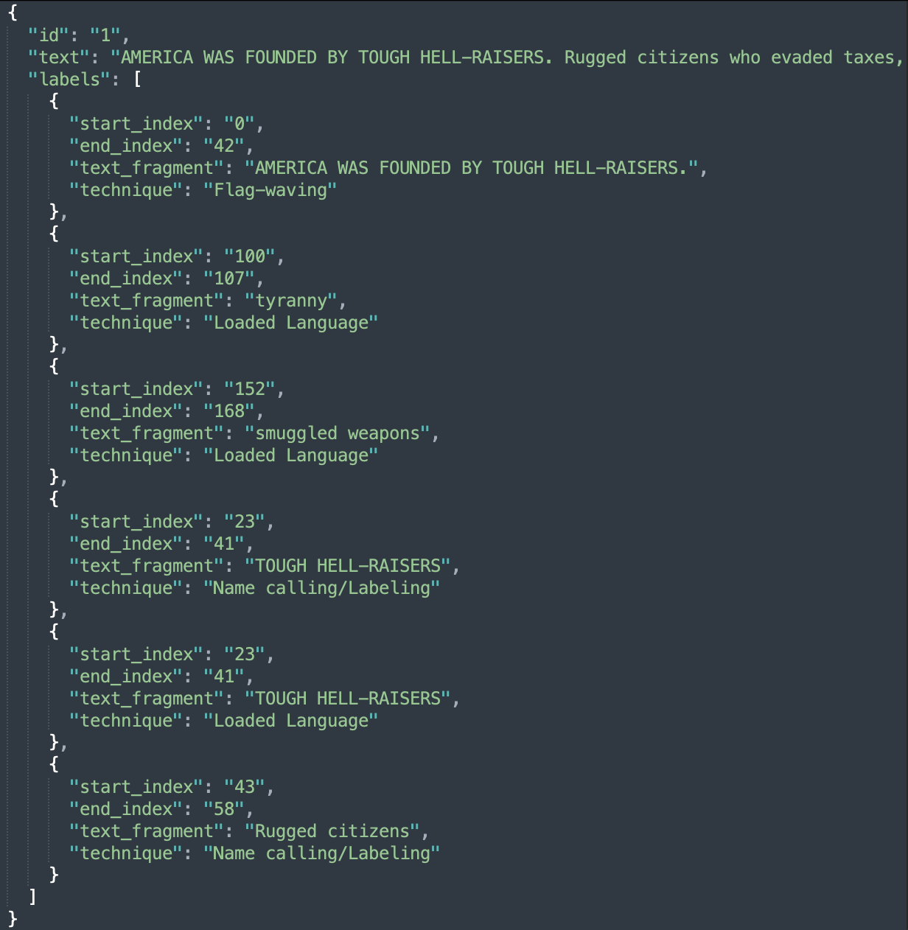
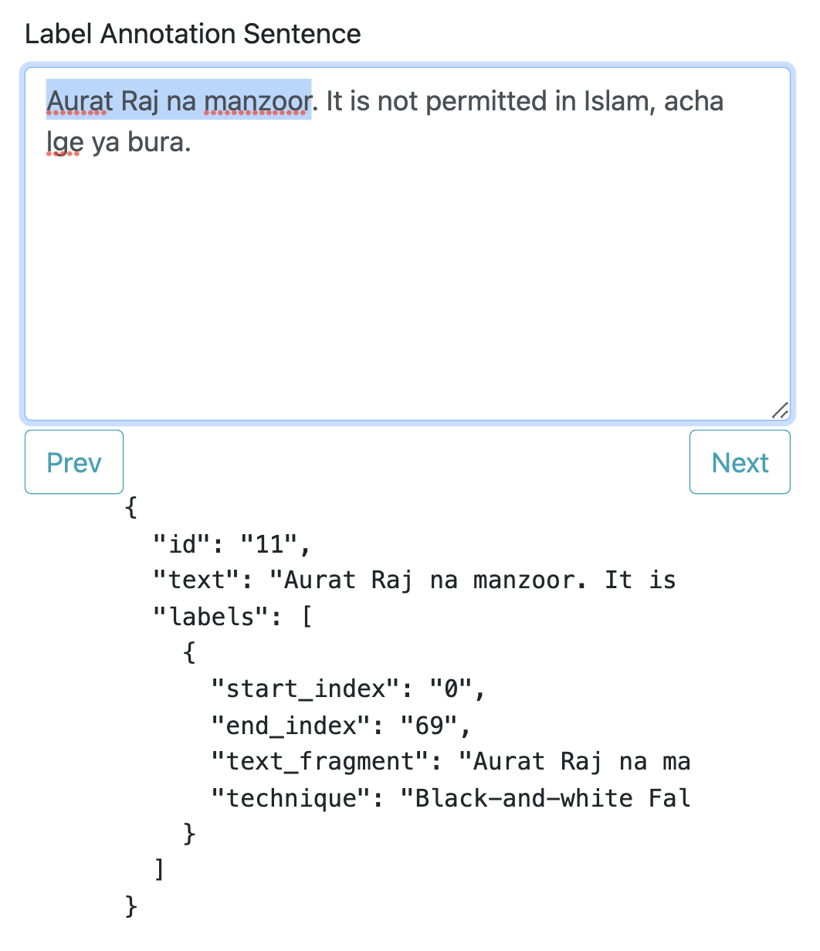
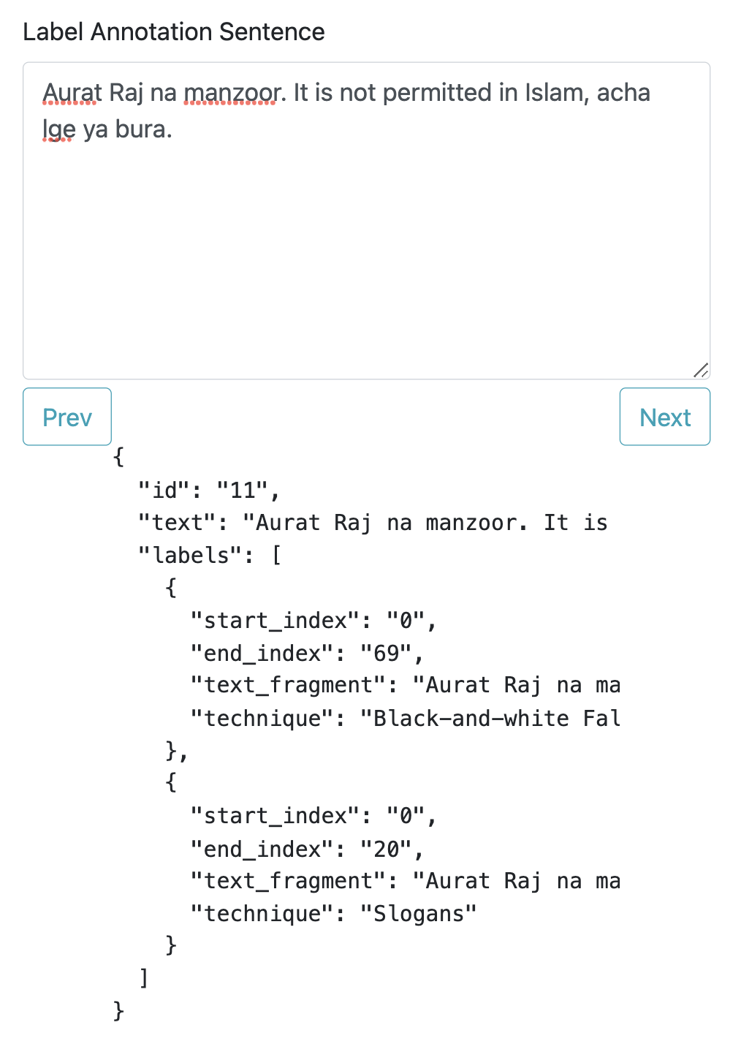
Annotation Platform

Slide 14
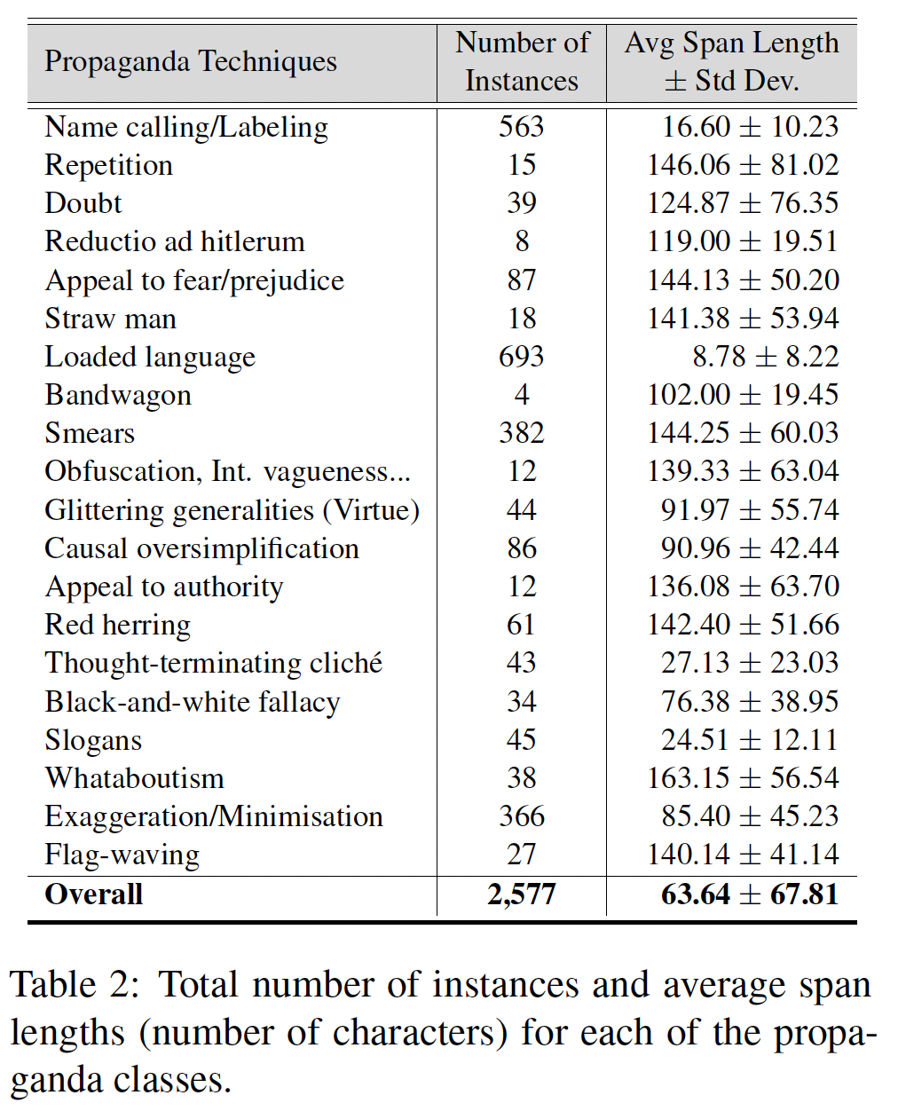
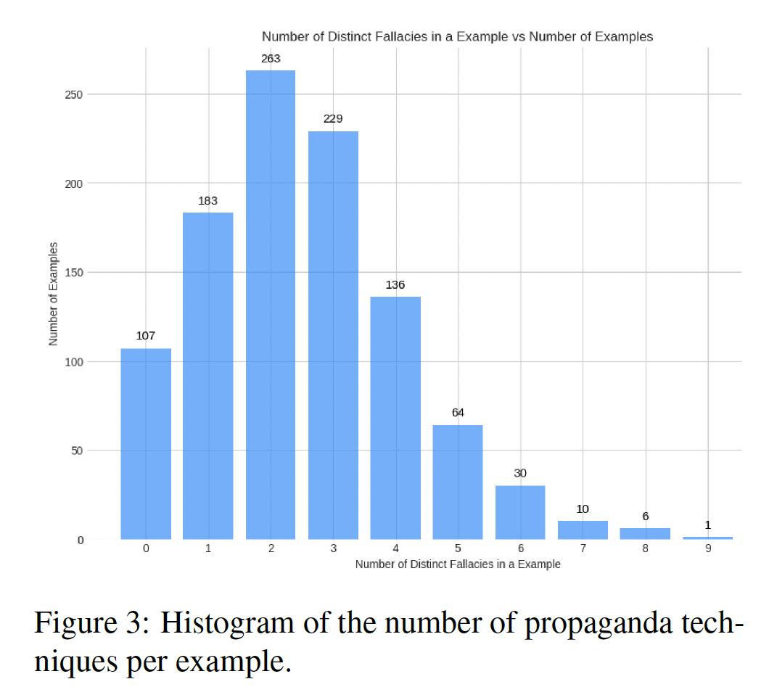
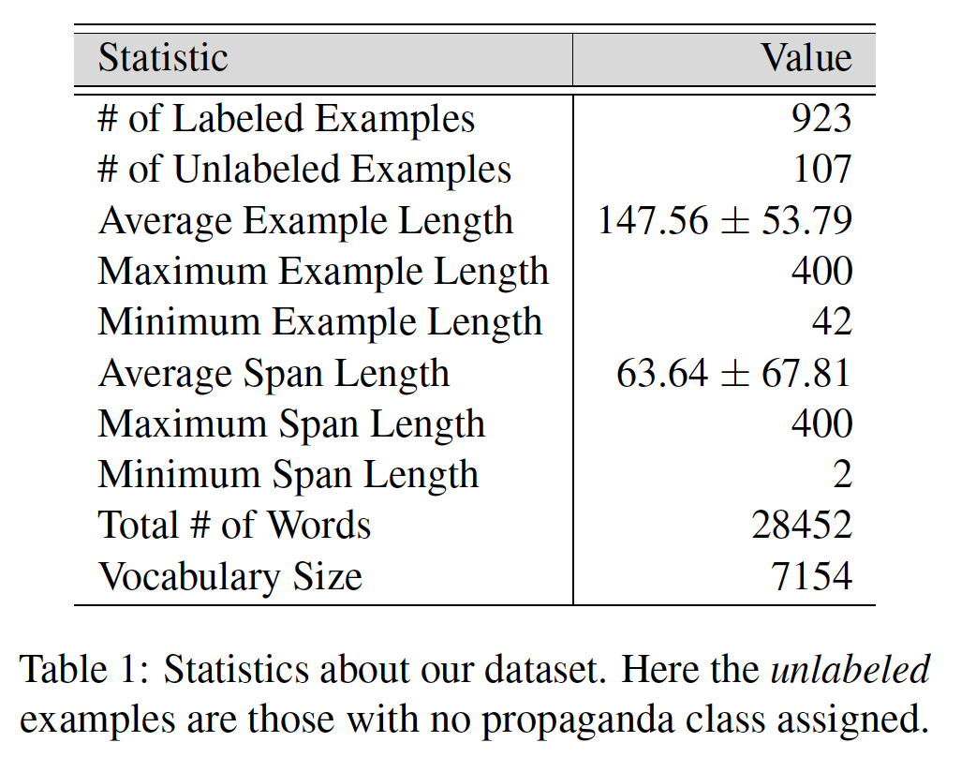
Dataset Statistics

Slide 15
Experiments and Results

Slide 16
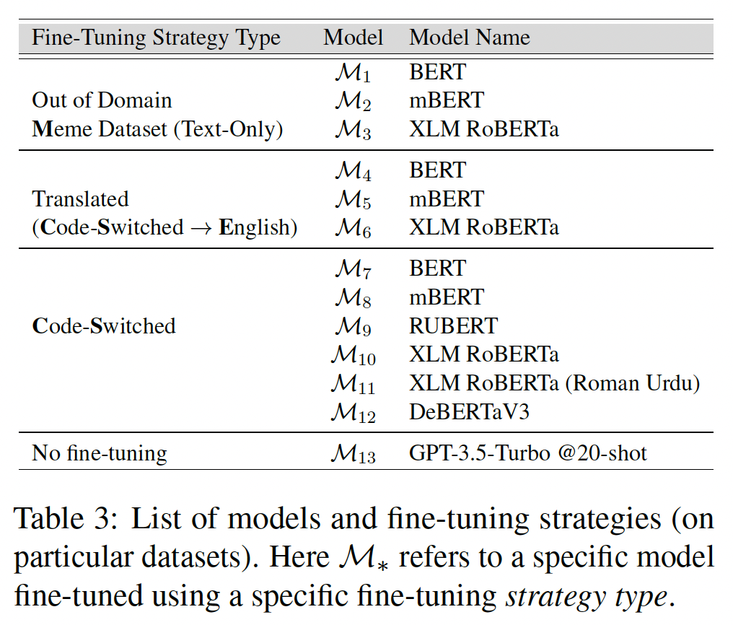
Fine-Tuning Strategies
Out of Domain [1]
Translated (Code-switched to English) [2]
Code-Switched
No fine-tuning
Dimitrov, Dimitar, et al. "Detecting propaganda techniques in memes." arXiv preprint arXiv:2109.08013 (2021).
https://cloud.google.com/translate/docs/

Slide 17
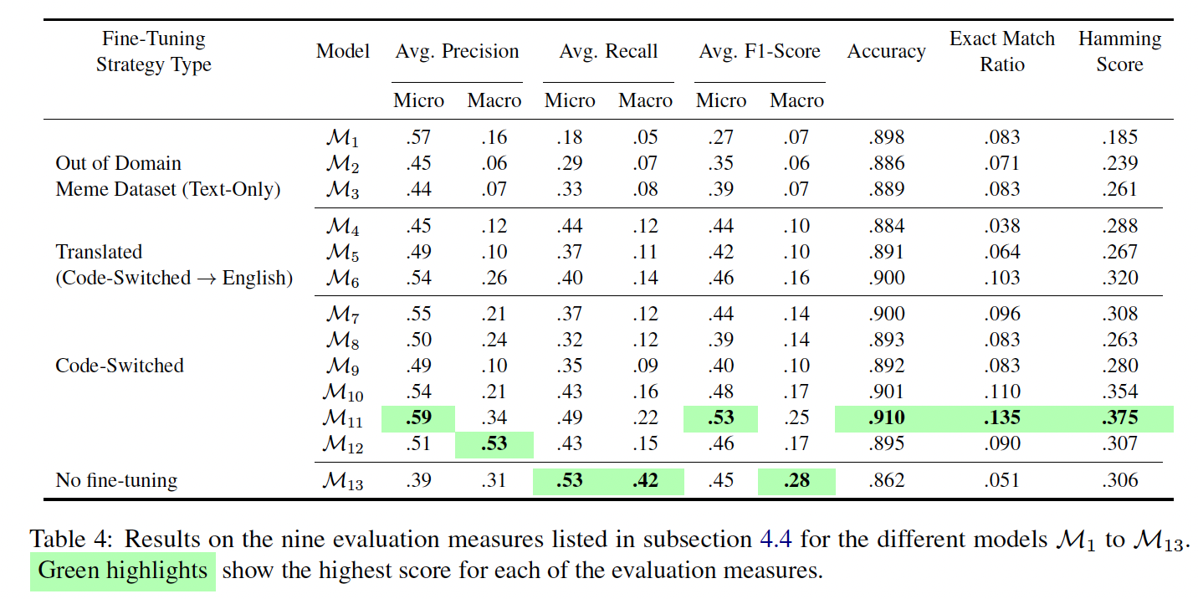
Experiment

Slide 18
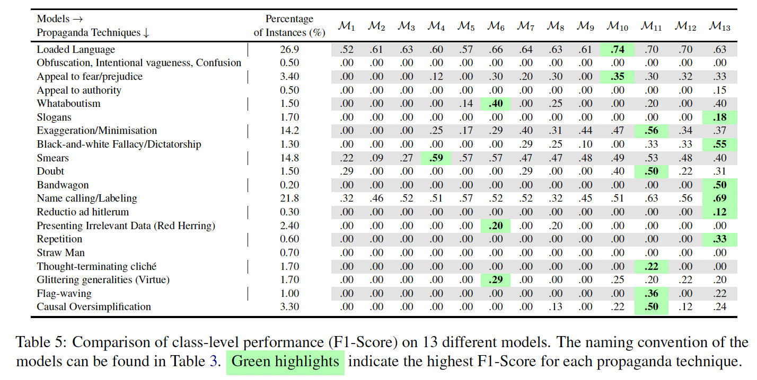
Experiment

Slide 19
Conclusion & Future Work

Slide 20
Conclusion
Novel task detecting propaganda techniques in code-switched text
Created corpus of 1030 code-switched annotated with 20 propaganda techniques
Run preliminary experiments using different fine-tuning strategies and models
Find modelling multilinguality rather than using translation is more effective for our task

Slide 21
Future Work
Expand our annotated corpus with many more examples
Run our experiments for our task for other resource-poor languages and compare results
See how different models and fine-tuning strategies perform on detecting propaganda on a fragment level
We want to understand the best strategy for handling codeswitched text with LLMs

Slide 22
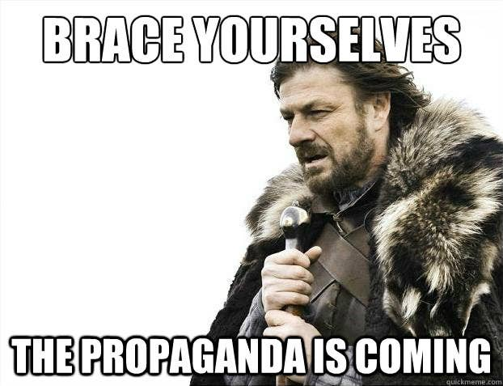
Thank you

